Slide 1


Slide 2



Janus
Problem with safety in NYC
People feel unsafe walking in NYC.
7 in 10 New Yorkers concerned about being violent crime victim: poll
NYC ranks No. 1 as deadliest city for pedestrians, study suggests

Slide 3


Janus
Janus calculates the safety of possible paths from Point A to B, helping you with the SAFEST Route for your walk.
Introducing Janus: Safest Route Finder

Slide 4

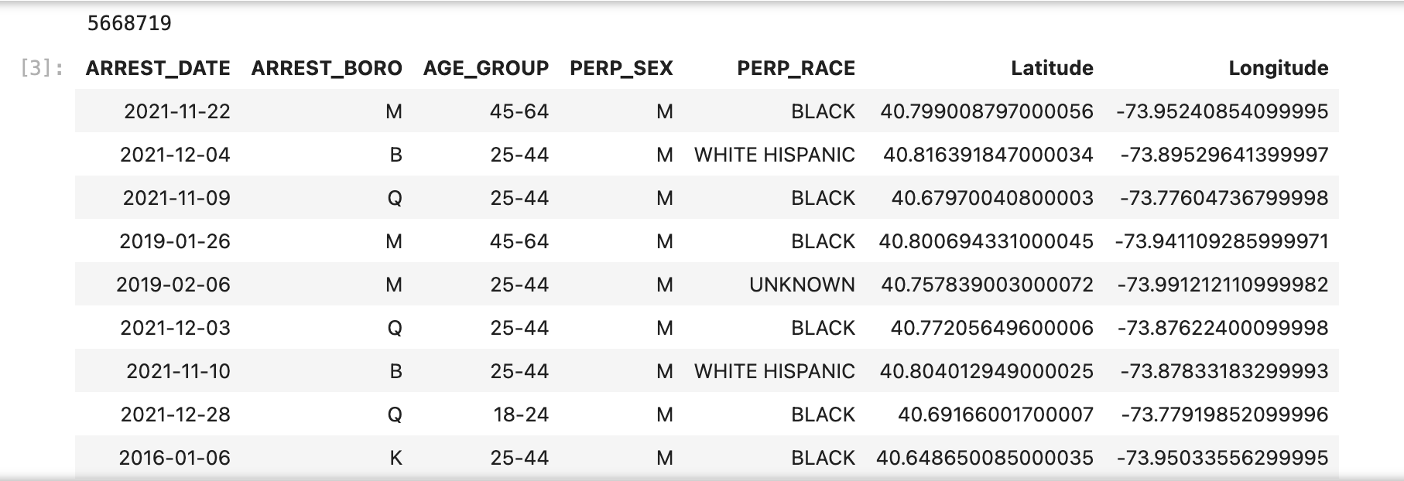


Janus
Data Sources
~ 5.6 million arrest records from Jan 2006 till Sep 2023.
NYPD Arrests Data (Historic) NYPD Arrest Data (Year to Date)

Slide 5


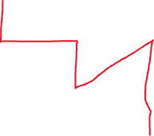
Janus
The risk score of a zone is the average no. of crimes reported in a particular zone per day
5 | 3 | 12 | 15 | 9 |  |  |  | 1
 | 7
 |  | 2 |  |  |  | 45
 |  |  |  |  | 15
 |  |  | 76 |  | 6 |  |  |  | 1
 |  | 32 |  |  |  | 3 |  |  | 1
 |  |  | 12 |  |  |  |  |  | 2
 |  |  |  |  |  |  |  |  | 4
 |  |  |  |  |  |  |  |  | 6
Route 1: [7+0+76+0+15+6] = 104/13 = 8
Route-2: [7+2+0+6] =15/10 = 1.5

Slide 6
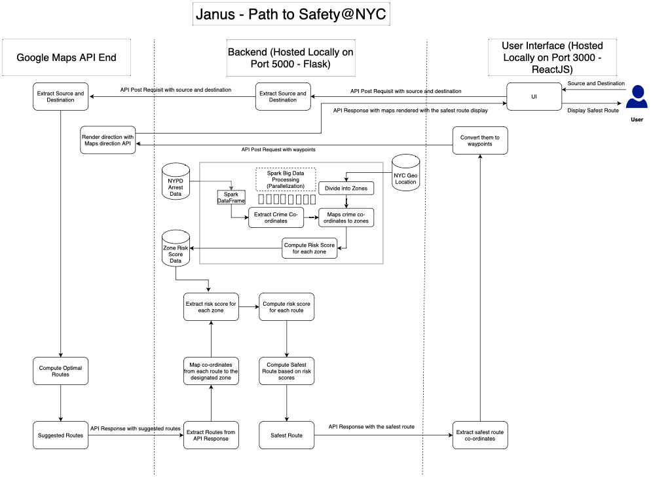
Janus
Architecture

Slide 7
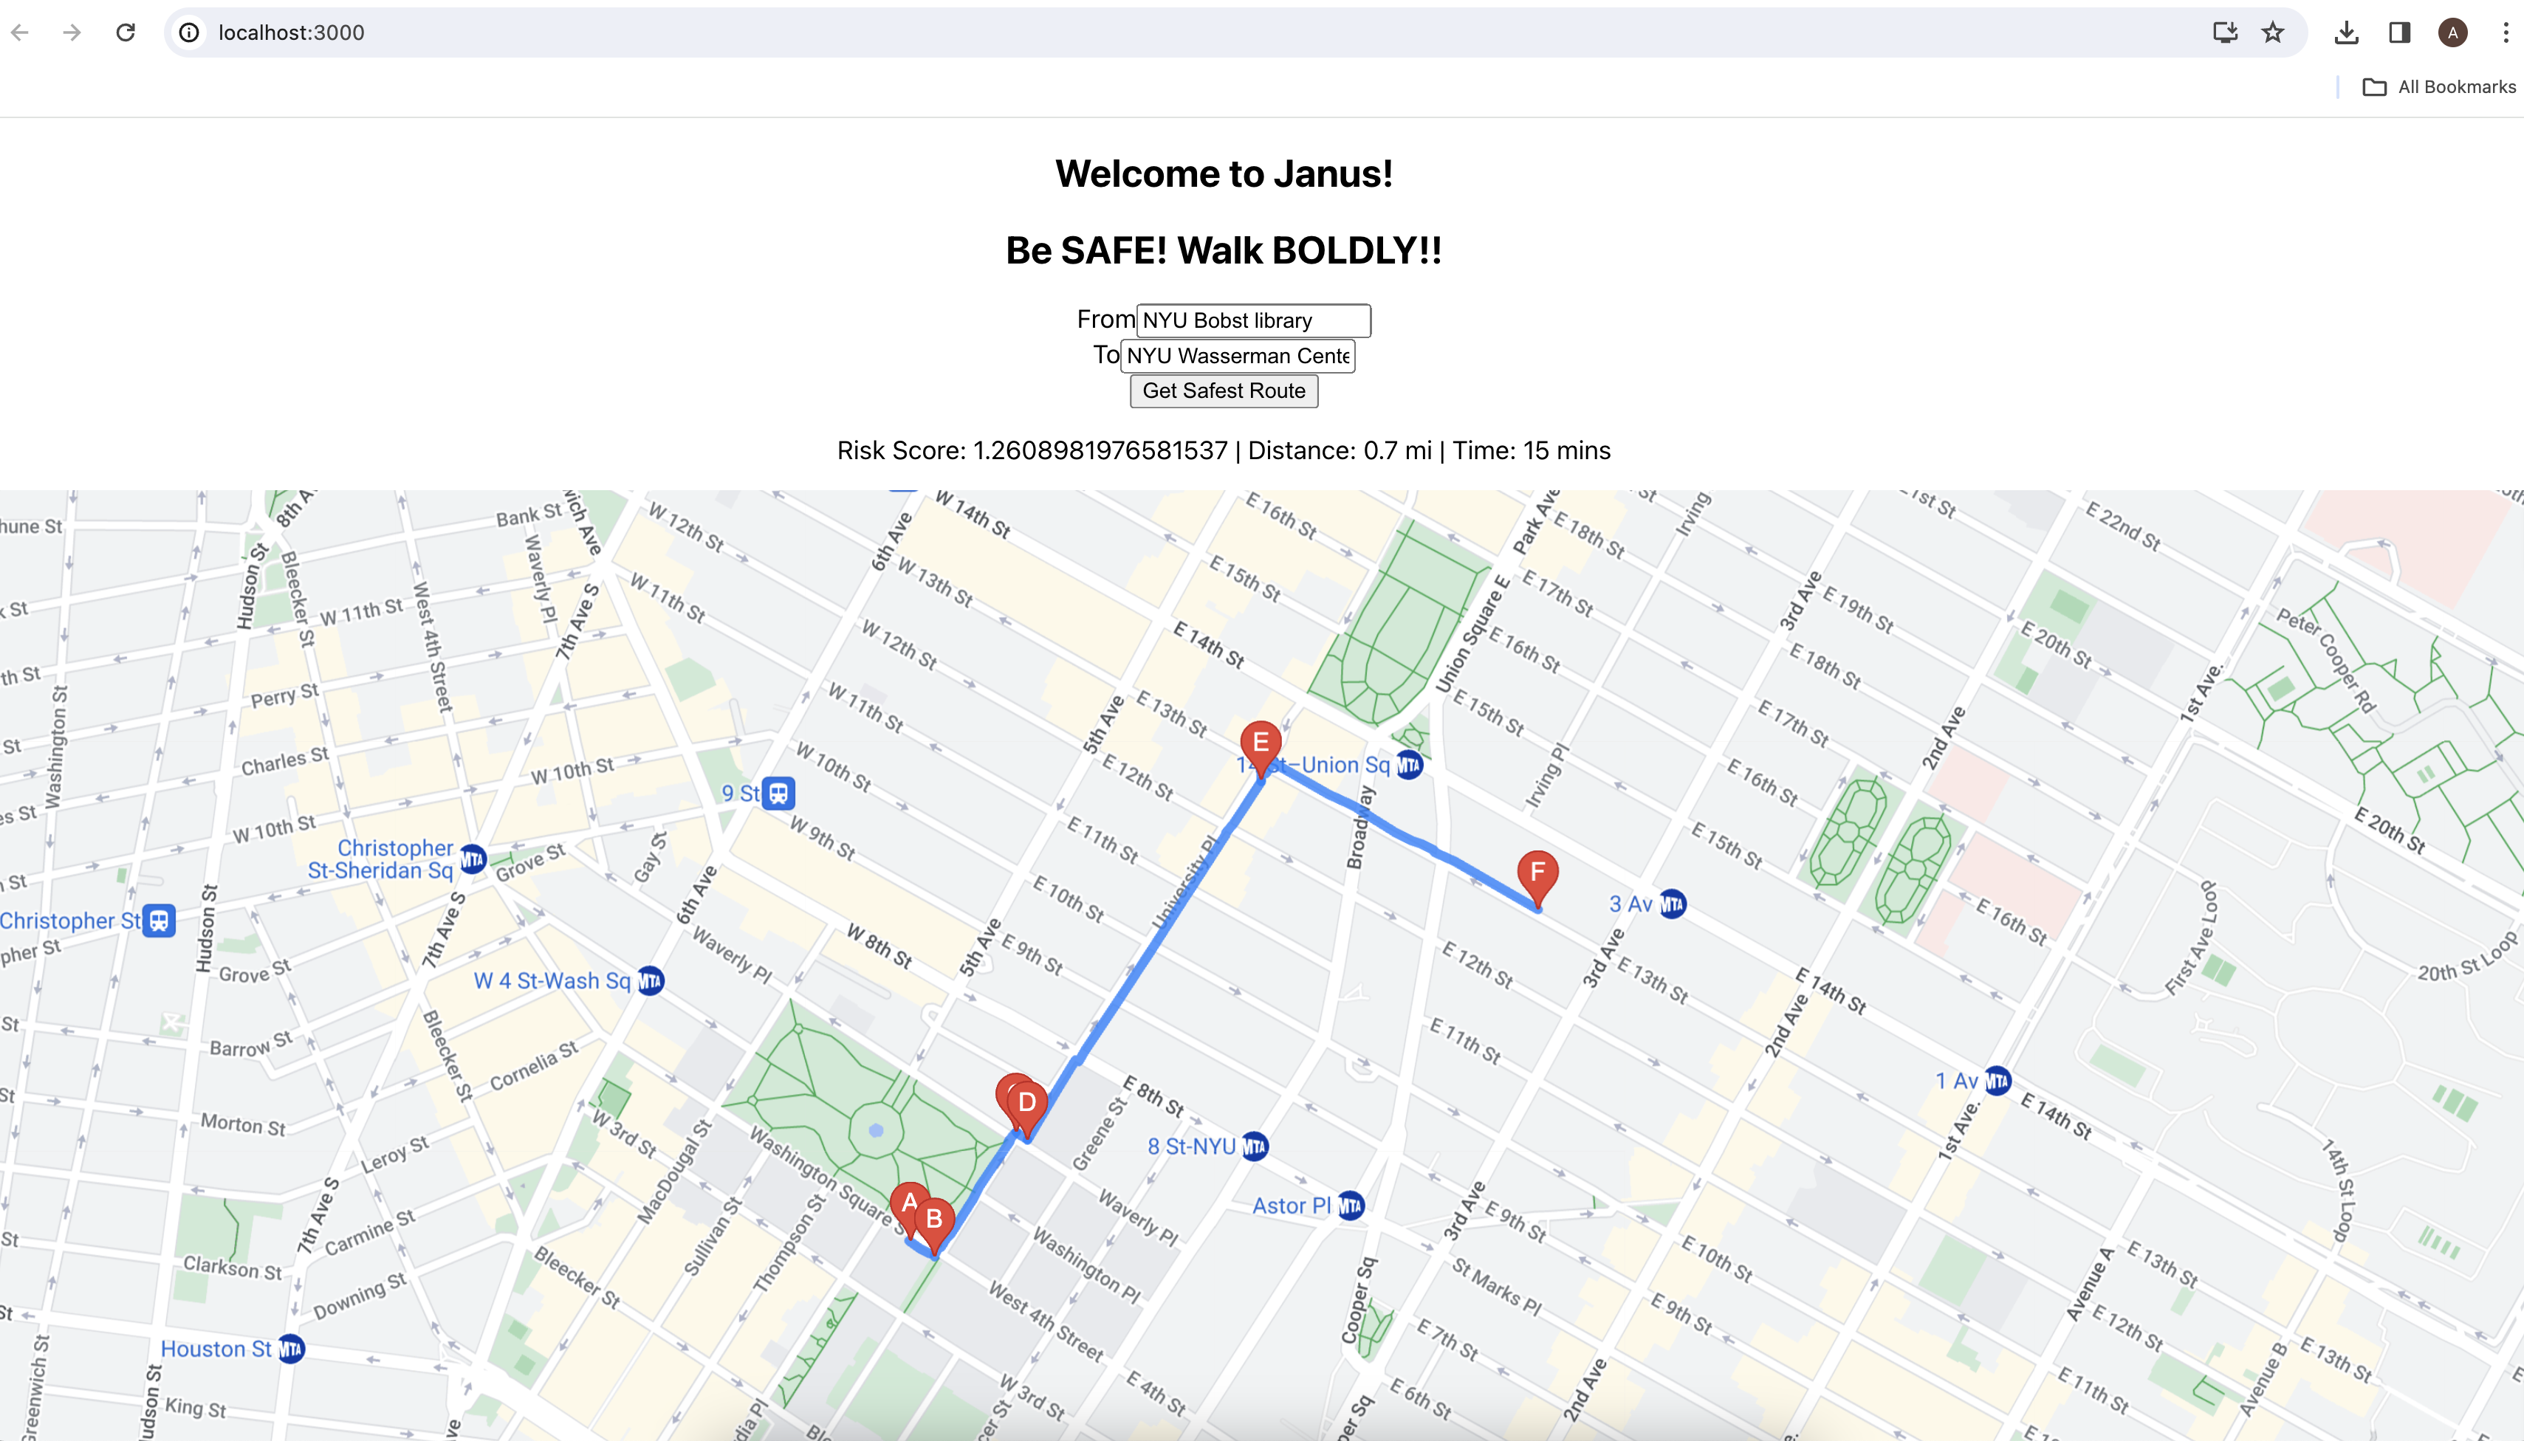

Janus
DEMO

Slide 8
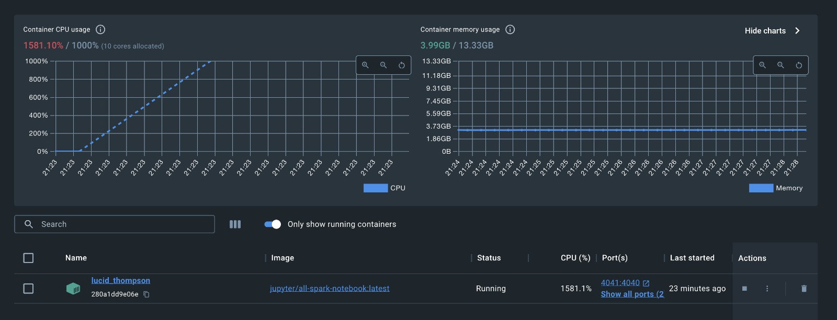
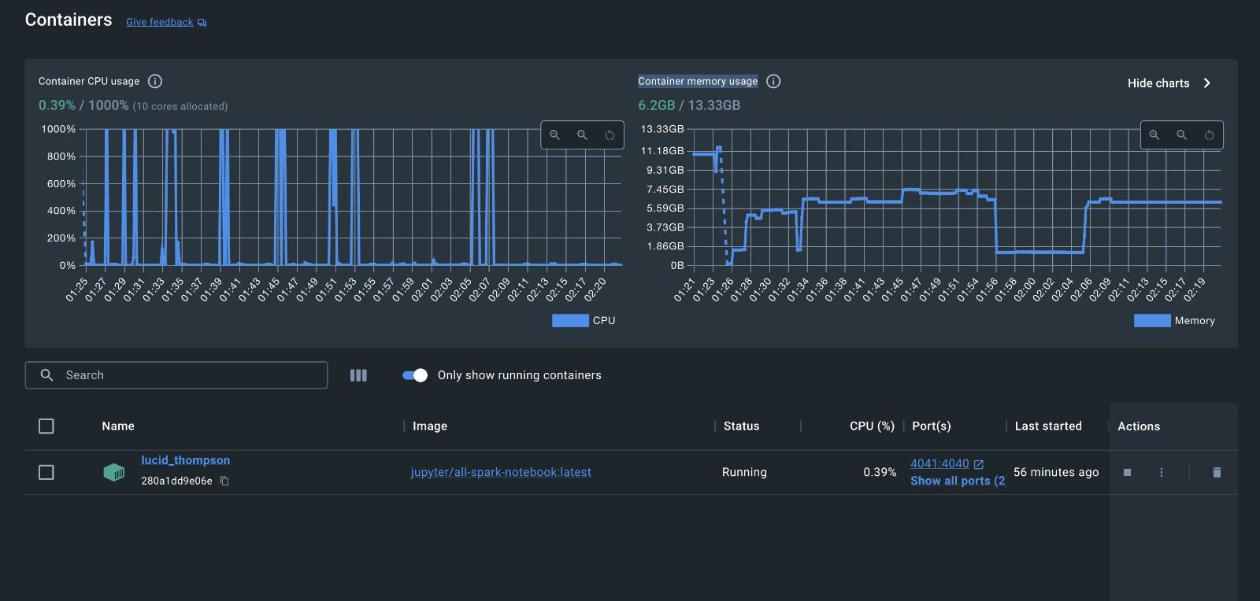

Janus
Challenges
Workaround
Not Efficient and Optimal Approach
Mapping coordinates over 5M records to 250K zones. (Join Operation)
(Resources: 14 GB Memory, 10 cores), time taken: 4 hours and counting
Efficient and Optimal
Mapping coordinates over 5M records to 25M zones. (using UDF)
(Resources: 14 GB Memory, 10 cores), time taken: ~ 1 min 20 sec

Slide 9
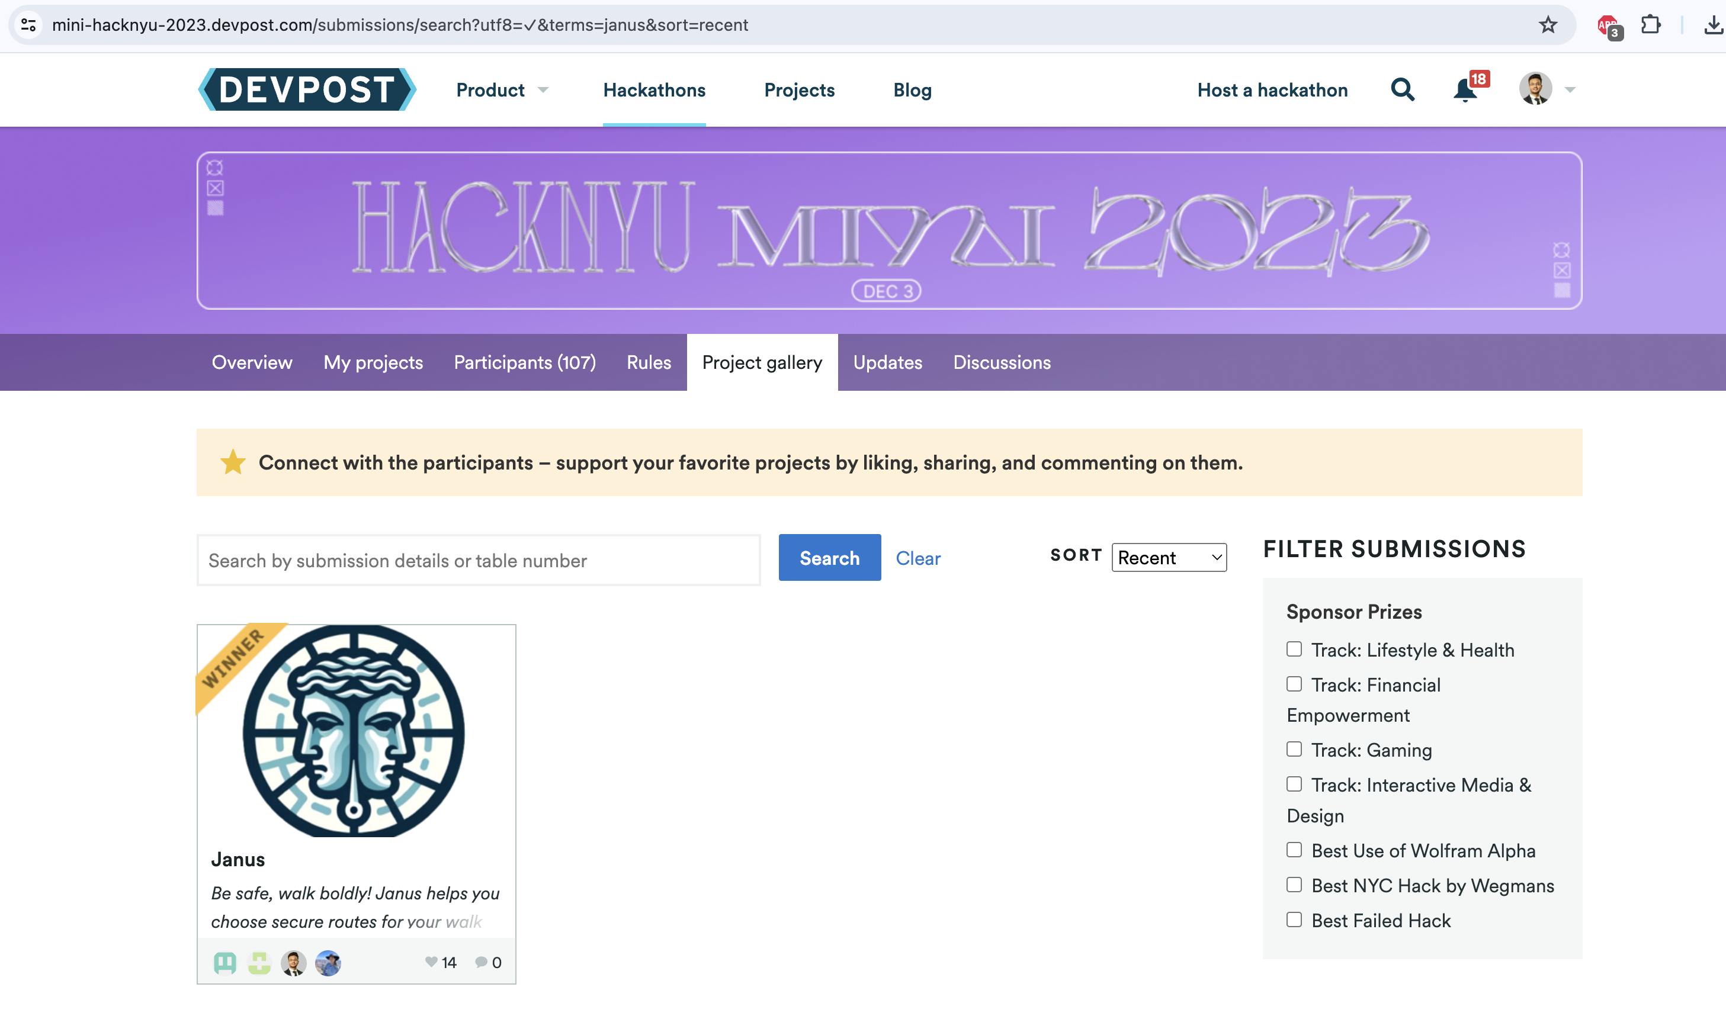

Janus

Slide 10

Janus
What’s next
Design the system using Spark Streaming to update risk scores every week/month.
Improve UI and integration with Google Maps
Questions?

